Slide 1
Topics
Intro
HPC
Federated Lab

Slide 2
Pytorch
https://pytorch.org/docs/stable/index.html

Slide 3
Environment Setup: OnDemand
Use this link to register and use ODU HPC services
ODU HPC
Log in to On Demand
ODU On Demand HPC
ODU HPC Documentation
Docs

Slide 4
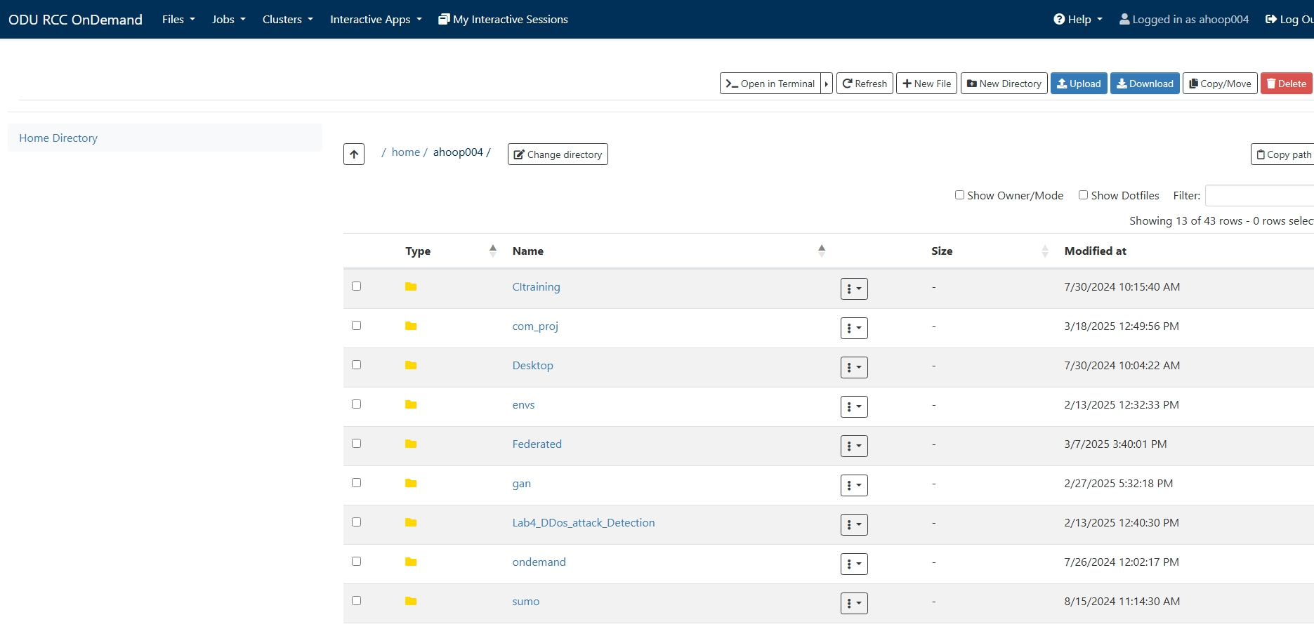
HPC: home/user

Slide 5
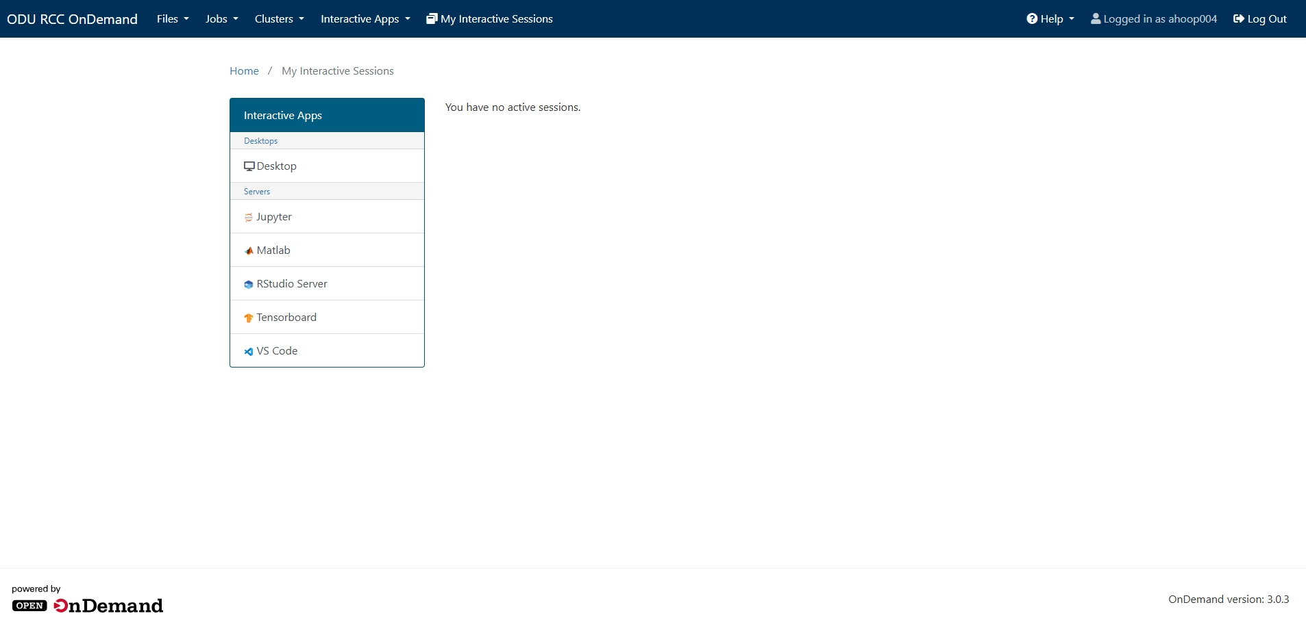
HPC: Jupyter

Slide 6
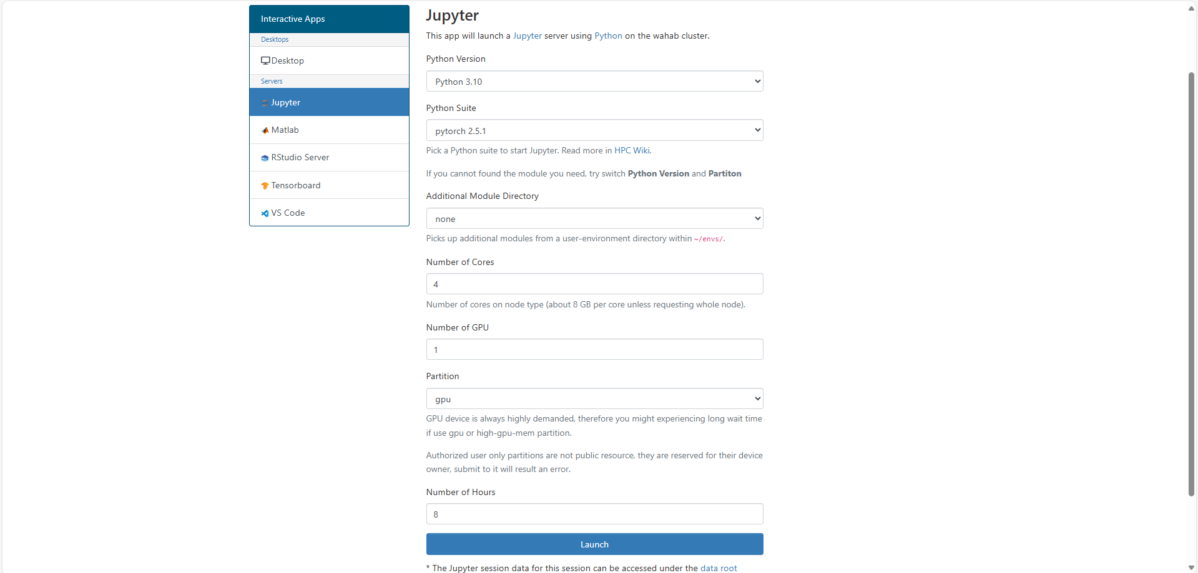
HPC: Launch

Slide 7
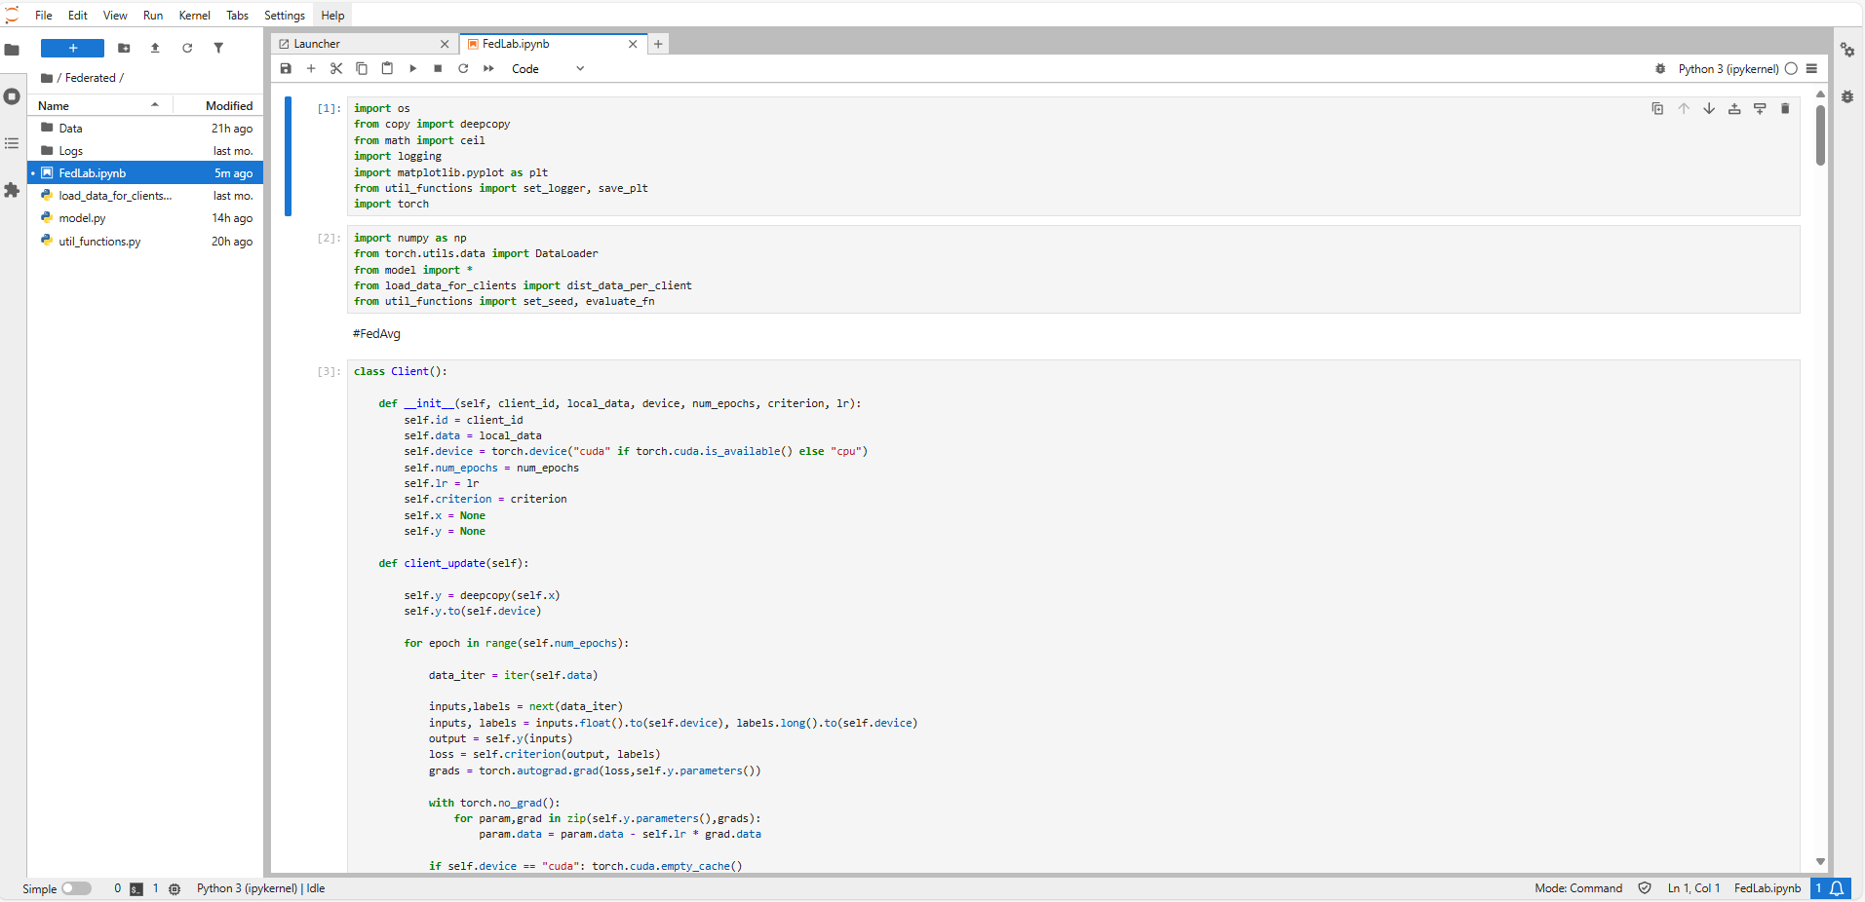
HPC: Navigate to lab

Slide 8
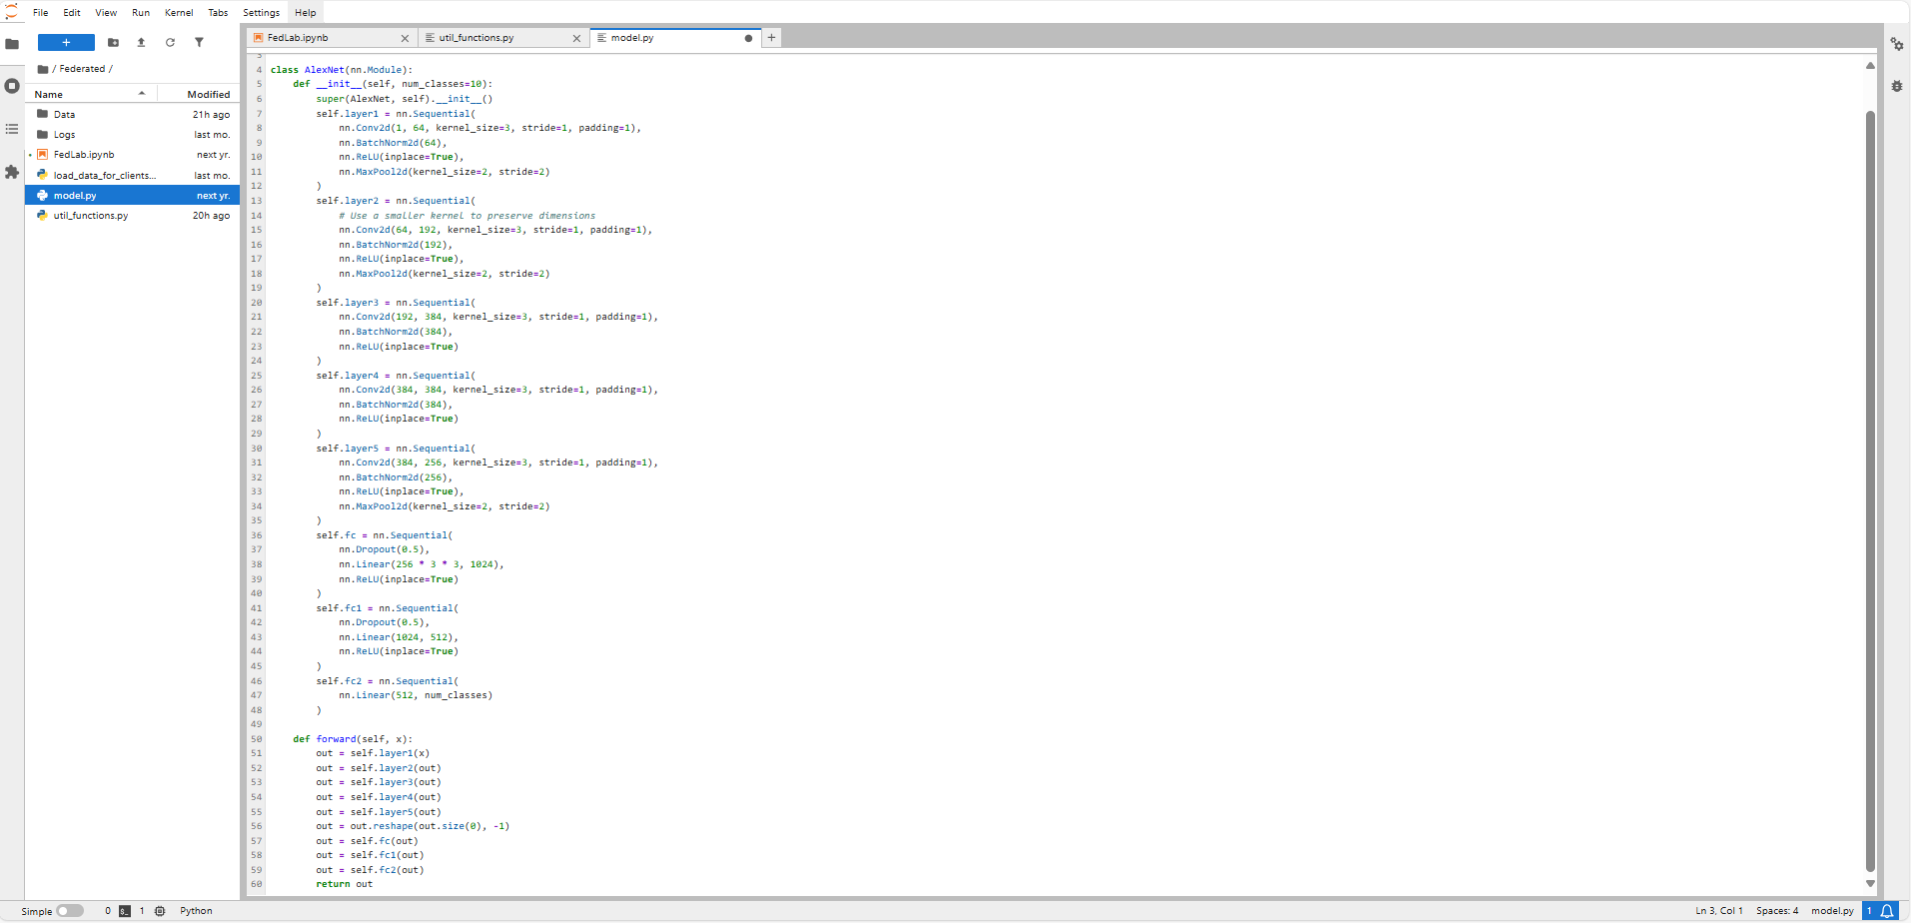
Model: Alexnet

Slide 9
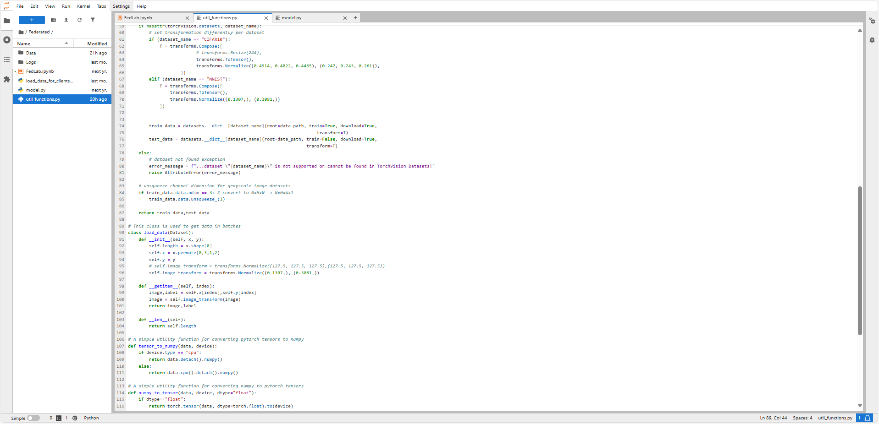
Utility functions: Data

Slide 10
Federated Learning Lab
Based on the work of
Balaji Varatharajan

Slide 11
Reference code and presentation
GitHub - BalajiAI/Federated-Learning: Implementation of Federated Learning algorithms such as FedAvg, FedAvgM, SCAFFOLD, FedOpt, Mime using PyTorch.
Aggregation algorithms in Federated Learning

Slide 12
Papers
FedAvg:[1602.05629] Communication-Efficient Learning of Deep Networks from Decentralized Data
FedOpt:(adam,adagrad,yogi):[2003.00295] Adaptive Federated Optimization
SCAFFOLD:[1910.06378] SCAFFOLD: Stochastic Controlled Averaging for Federated Learning

Slide 13
Base Federated Learning Vocabulary
Federated Learning (FL): A distributed learning paradigm where multiple clients (devices) train a shared model without centralizing data.
Client: The individual devices or nodes that perform local training on private data.
Server: The central coordinator that aggregates updates from clients.
Local Update: The process where each client trains the model on its local data.
Global Model: The aggregated model obtained after combining client updates.
Federated Averaging (FedAvg): The baseline aggregation algorithm that averages client model updates.
Communication Round: A complete cycle of local training and subsequent aggregation on the server.
Data Heterogeneity (Non-IID Data): The variability in data distribution across different clients.
Privacy Preservation: Techniques used to ensure client data remains private during training.
Scalability: The system’s ability to handle a large number of clients efficiently.

Slide 14



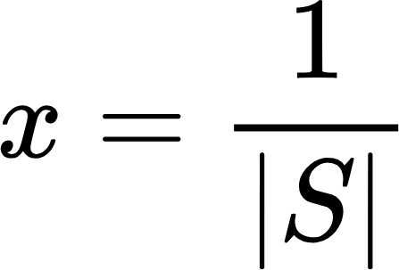
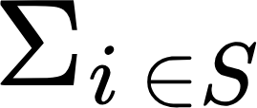

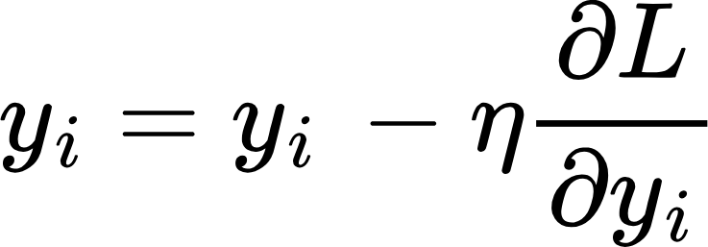


FedAvg

Slide 15
FedAvg
grads = torch.autograd.grad(loss,self.y.parameters())
with torch.no_grad():
for param,grad in zip(self.y.parameters(),grads):
param.data = param.data - self.lr * grad.data
with torch.no_grad():
for idx in client_ids:
for a_y, y in zip(avg_y, self.clients[idx].y.parameters()):
a_y.data.add_(y.data / int(self.fraction * self.num_clients))
for param, a_y in zip(self.x.parameters(), avg_y):
param.data = a_y.data

Slide 16
Adaptive Federated Optimization Vocab
Adaptive Learning Rate: An approach where the learning rate is automatically adjusted based on historical gradient information.
FedAdam / FedAdagrad / FedYogi: Variants of adaptive optimizers (inspired by Adam, Adagrad, and Yogi) tailored for federated settings.
Momentum: A technique that incorporates previous updates to smooth and accelerate convergence.
Bias Correction: Adjustments made (e.g., in Adam) to correct the estimates of moment statistics.
Gradient Scaling: Methods to adjust gradients (or learning rates) based on their magnitudes or variance.
Optimizer Hyperparameters: Parameters such as beta coefficients in Adam that control decay rates and other dynamics.
Convergence Stability: The algorithm's ability to reliably reach a minimum despite data heterogeneity and noisy gradients.
Client Drift: The divergence in local updates due to non-IID data that adaptive methods aim to counteract.

Slide 17
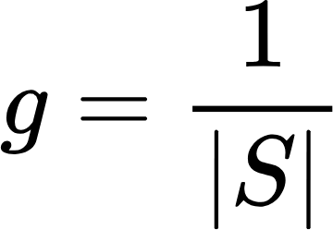
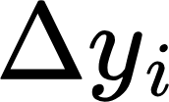
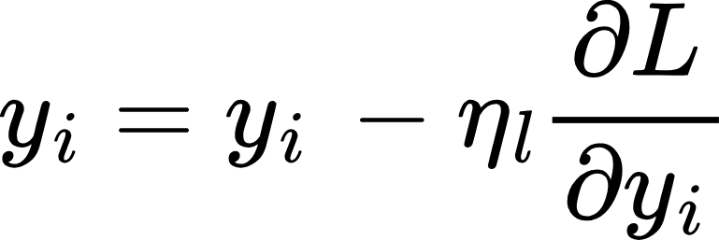
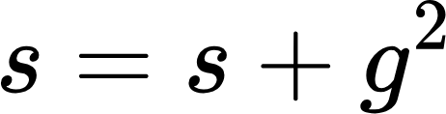
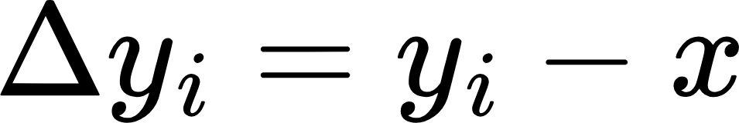
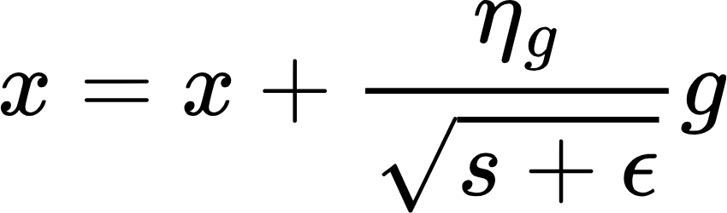
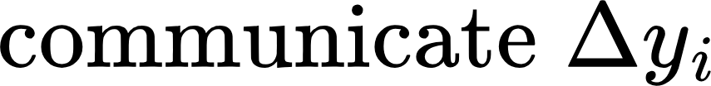
FedAdagrad

Slide 18
FedAdagrad
with torch.no_grad():
for param,grad in zip(self.y.parameters(),grads):
param.data = param.data - self.lr * grad.data
with torch.no_grad():
for idx in client_ids:
for grad, diff in zip(gradients, self.clients[idx].delta_y):
grad.data.add_(diff.data / int(self.fraction * self.num_clients))
with torch.no_grad():
delta_y = [torch.zeros_like(param, device=self.device) for param in self.y.parameters()]
for del_y, param_y, param_x in zip(delta_y, self.y.parameters(), self.x.parameters()):
del_y.data += param_y.data.detach() - param_x.data.detach()
self.delta_y = delta_y
for p,g,s in zip(self.x.parameters(), gradients, self.s):
s.data += torch.square(g.data)
p.data += self.lr * g.data / torch.sqrt(s.data + self.epsilon)

Slide 19
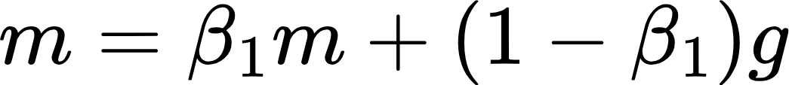
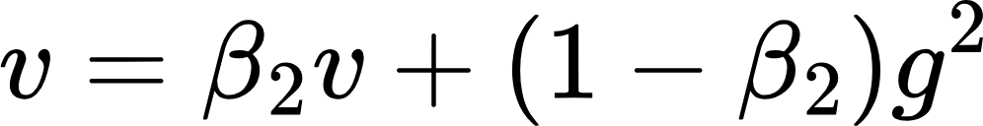
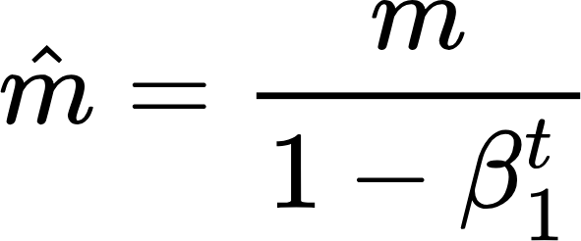
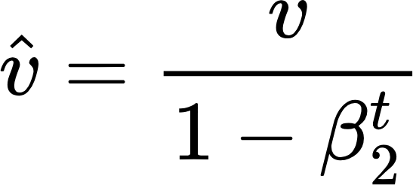
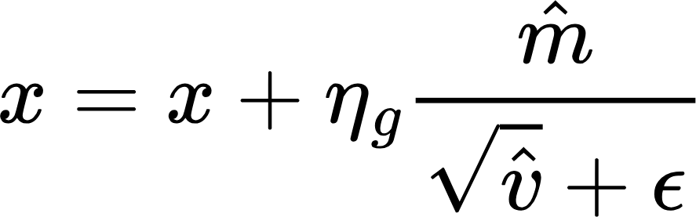
FedAdam

Slide 20
FedAdam
with torch.no_grad():
for idx in client_ids:
for grad, diff in zip(gradients, self.clients[idx].delta_y):
grad.data.add_(diff.data / int(self.fraction * self.num_clients))
for p,g,m,v in zip(self.x.parameters(), gradients, self.m, self.v):
m.data = self.beta1 * m.data + (1 - self.beta1) * g.data
v.data = self.beta2 * v.data + (1 - self.beta2) * torch.square(g.data)
m_bias_corr = ################################################################
v_bias_corr = ################################################################
p.data += self.lr * m_bias_corr / (torch.sqrt(v_bias_corr) + self.epsilon)

Slide 21
FedYogi

Slide 22
FedYogi
with torch.no_grad():
for idx in client_ids:
for grad, diff in zip(gradients, self.clients[idx].delta_y):
grad.data.add_(diff.data / int(self.fraction * self.num_clients))
for p,g,m,v in zip(self.x.parameters(), gradients, self.m, self.v):
m.data = self.beta1 * m.data + (1 - self.beta1) * g.data
v.data = v.data + (1 - self.beta2) * torch.sign( torch.square(g.data) - v.data) * torch.square(g.data)
m_bias_corr = ################################################################
v_bias_corr = ################################################################
p.data += self.lr * m_bias_corr / (torch.sqrt(v_bias_corr) + self.epsilon)

Slide 23
SCAFFOLD Vocab
SCAFFOLD: Stochastic Controlled Averaging for Federated Learning; a method to correct client drift.
Control Variates: Auxiliary variables used to reduce variance in local updates and correct for client drift.
Client Control Variate: A variable maintained at each client to adjust local updates based on estimated drift.
Server Control Variate: The aggregate control variable maintained by the server to guide correction across clients.
Drift Correction: The process of adjusting updates to counter the bias introduced by heterogeneous data distributions.
Variance Reduction: Techniques used to decrease the variability in gradient estimates, enhancing convergence.
Local Gradient Correction: Specific adjustments made to local gradients using control variates.
Stochastic Optimization: The broader framework that underpins methods like SCAFFOLD, dealing with randomness in gradient updates.
Update Correction: The mechanism to adjust the direction and magnitude of client updates based on control variates.

Slide 24

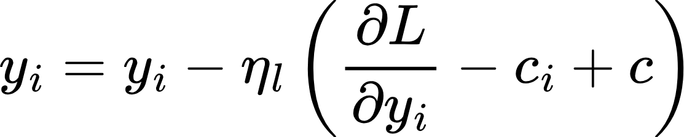
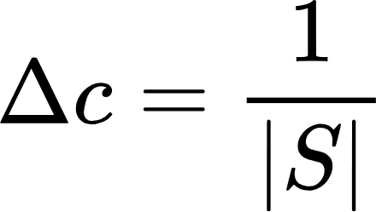
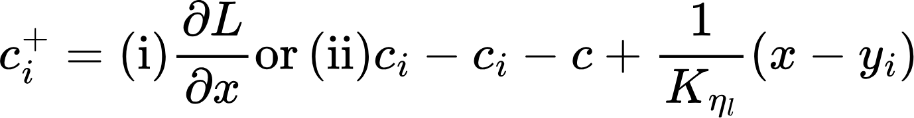


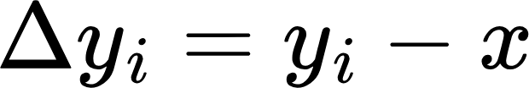
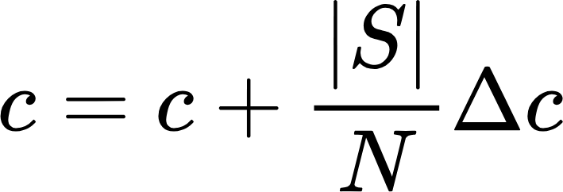
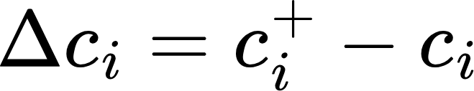
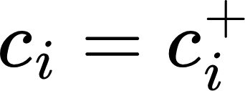
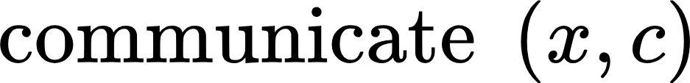
Scaffold(Stochastic Controlled Averaging for Federated Learning)

Slide 25
Scaffold(Stochastic Controlled Averaging for Federated Learning)
def client_update(self):
self.x.to(self.device)
self.y = deepcopy(self.x) #Initialize local model
self.y.to(self.device)
for epoch in range(self.num_epochs):
data_iter = iter(self.data)
inputs,labels = next(data_iter)
inputs, labels = inputs.float().to(self.device), labels.long().to(self.device)
output = self.y(inputs)
loss = self.criterion(output, labels)
grads = torch.autograd.grad(loss,self.y.parameters())
with torch.no_grad():
for param,grad,s_c,c_c in zip(self.y.parameters(),grads,self.server_c,self.client_c):
s_c, c_c = s_c.to(self.device), c_c.to(self.device)
param.data = param.data - self.lr * (grad.data + (s_c.data - c_c.data))
if self.device == "cuda": torch.cuda.empty_cache()
with torch.no_grad():
delta_y = [torch.zeros_like(param, device=self.device) for param in self.y.parameters()]
delta_c = deepcopy(delta_y)
new_client_c = deepcopy(delta_y)
for del_y, param_y, param_x in zip(delta_y, self.y.parameters(), self.x.parameters()):
del_y.data += param_y.data.detach() - param_x.data.detach()
a = (ceil(len(self.data.dataset) / self.data.batch_size)*self.num_epochs*self.lr)
for n_c, c_l, c_g, diff in zip(new_client_c, self.client_c, self.server_c, delta_y):
n_c.data += c_l.data - c_g.data - diff.data / a
for d_c, n_c_l, c_l in zip(delta_c, new_client_c, self.client_c):
d_c.data.add_(n_c_l.data - c_l.data)
self.client_c = deepcopy(new_client_c) #Update client_c with new_client_c
self.delta_y = delta_y
self.delta_c = delta_c

Slide 26
Scaffold(Stochastic Controlled Averaging for Federated Learning)
def server_update(self, client_ids):
self.x.to(self.device)
for idx in client_ids:
with torch.no_grad():
for param, diff in zip(self.x.parameters(), self.clients[idx].delta_y):
param.data.add_(diff.data * self.lr / int(self.fraction * self.num_clients))
for c_g, c_d in zip(self.server_c, self.clients[idx].delta_c):
c_g.data.add_(c_d.data * self.fraction)

Slide 27
780 goals
Familiarize yourself with the HPC environment
Complete code for Fed Adagrad and Fed Yogi
Choose one to run
Different dataset
Compare to baseline and Report

Slide 28
880
Beat FedAvg MNIST score: 84.07% with any algorithm/model combo
Hyperparameter tuning and report parameter impact
Apply iid and non-iid compare algorithms

